Slide 1

Streamlit and Gradio
AI VIETNAM
All-in-One Course
(TA Session)
Extra Class: MLOps
Nguyen-Thuan Duong – TA
Year 2024

Slide 2
AI VIETNAM
All-in-One Course
(TA Session)
Outline
Introduction
Web Application
Streamlit
Gradio
Hands-on
Conclusion
Question

Slide 3
AI VIETNAM
All-in-One Course
(TA Session)
Introduction

Slide 4
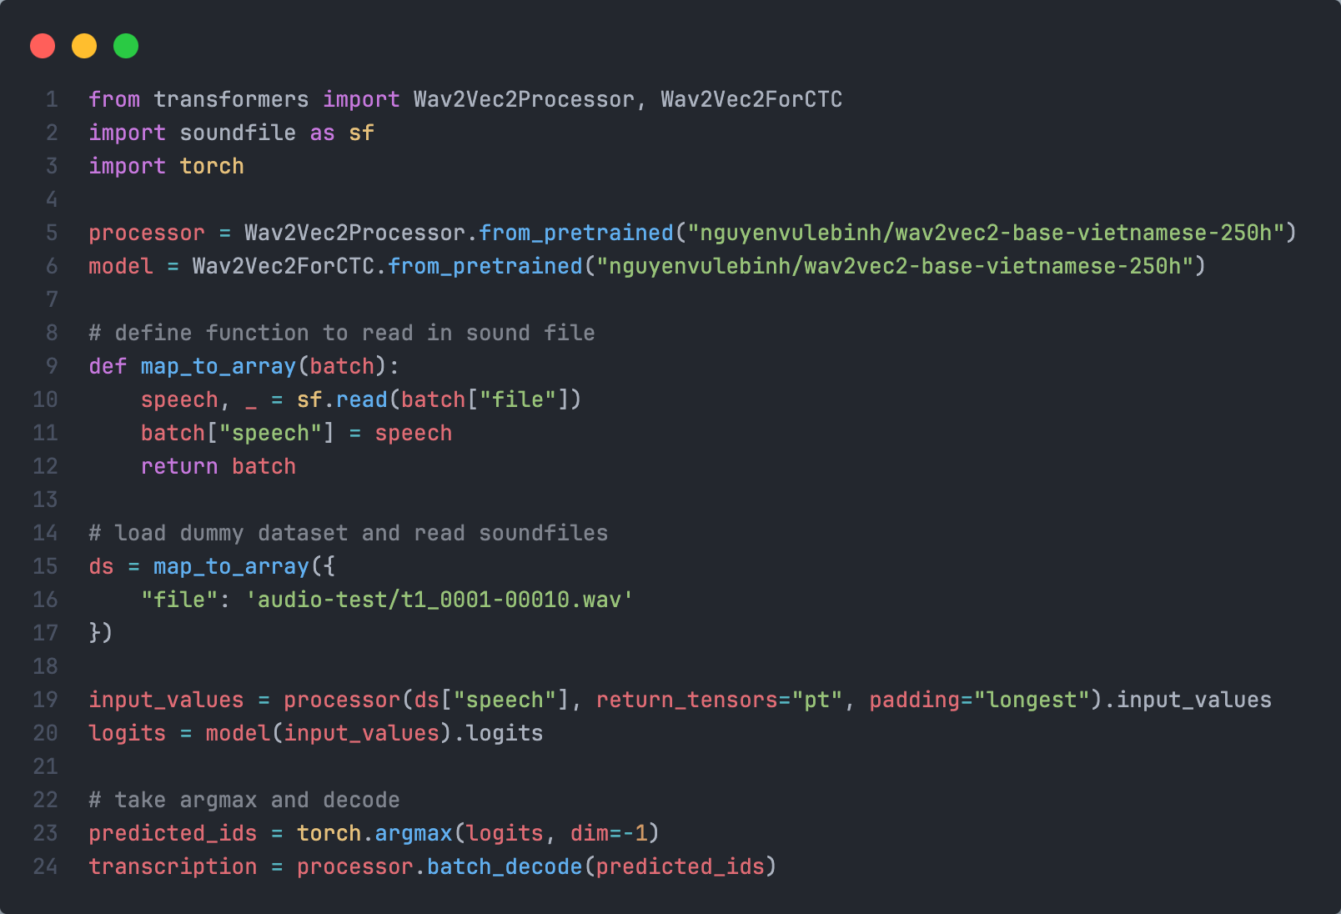

Introduction
AI VIETNAM
All-in-One Course
(TA Session)
Getting Started
Here is my new model
4

Slide 5



Introduction
AI VIETNAM
All-in-One Course
(TA Session)
Developer vs End-user
Here is my new model
Dev
????
End-user
5

Slide 6

Introduction
AI VIETNAM
All-in-One Course
(TA Session)
Development
☺
Developer
UI/App
End-user
6

Slide 7
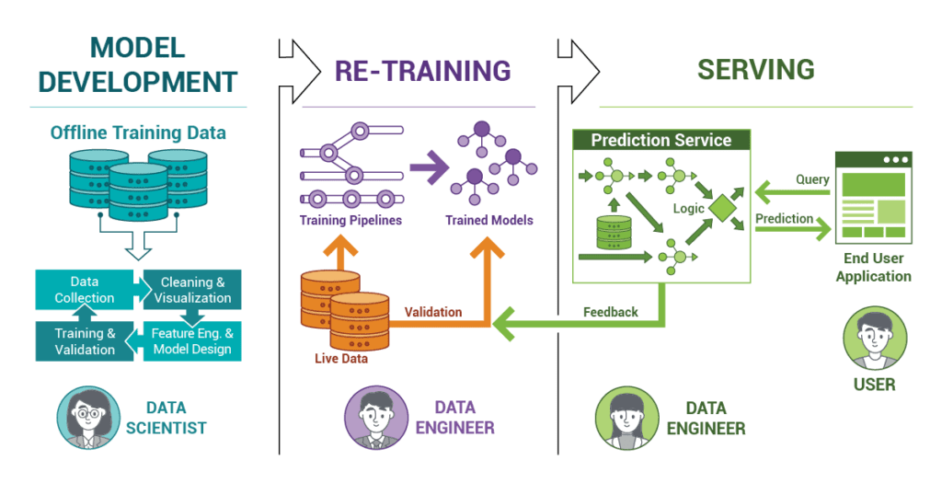
Introduction
AI VIETNAM
All-in-One Course
(TA Session)
Machine Learning Deployment
7

Slide 8
AI VIETNAM
All-in-One Course
(TA Session)
Web application

Slide 9
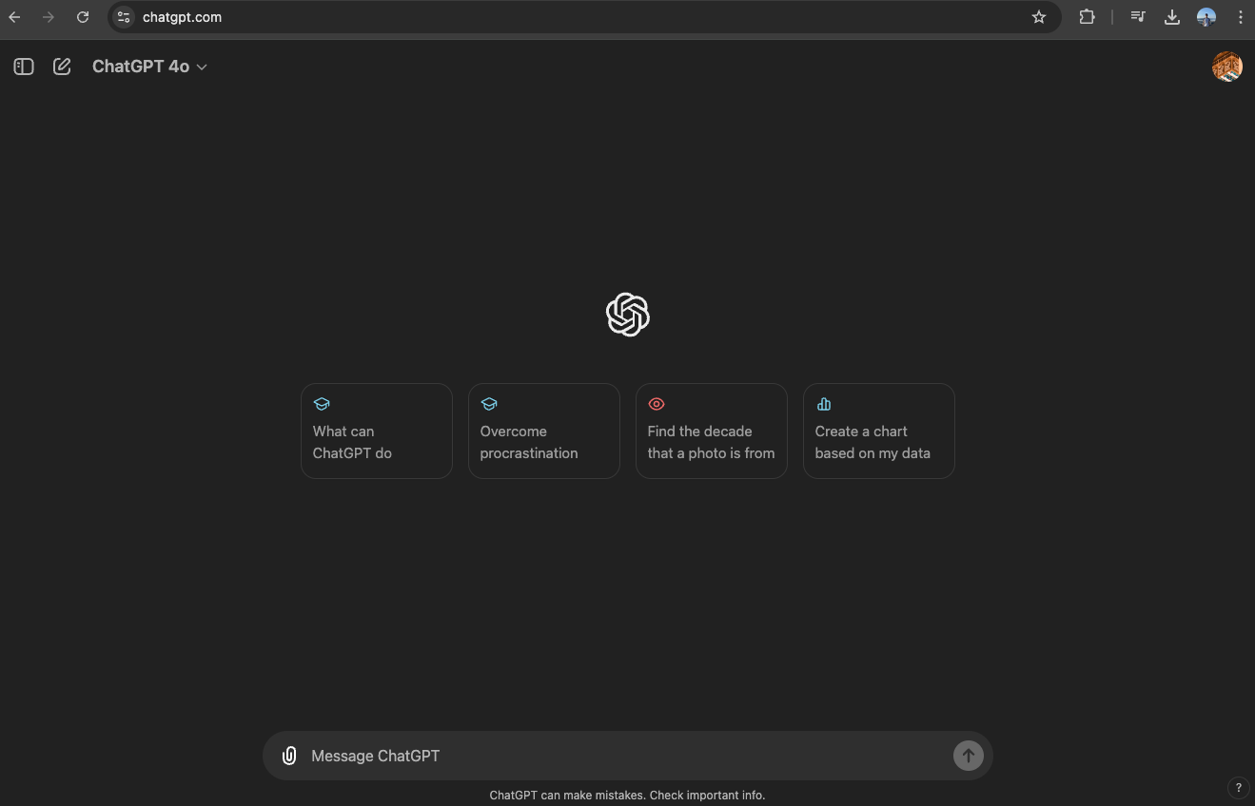
Web application
AI VIETNAM
All-in-One Course
(TA Session)
ChatGPT web application
Ref: https://chatgpt.com
9

Slide 10
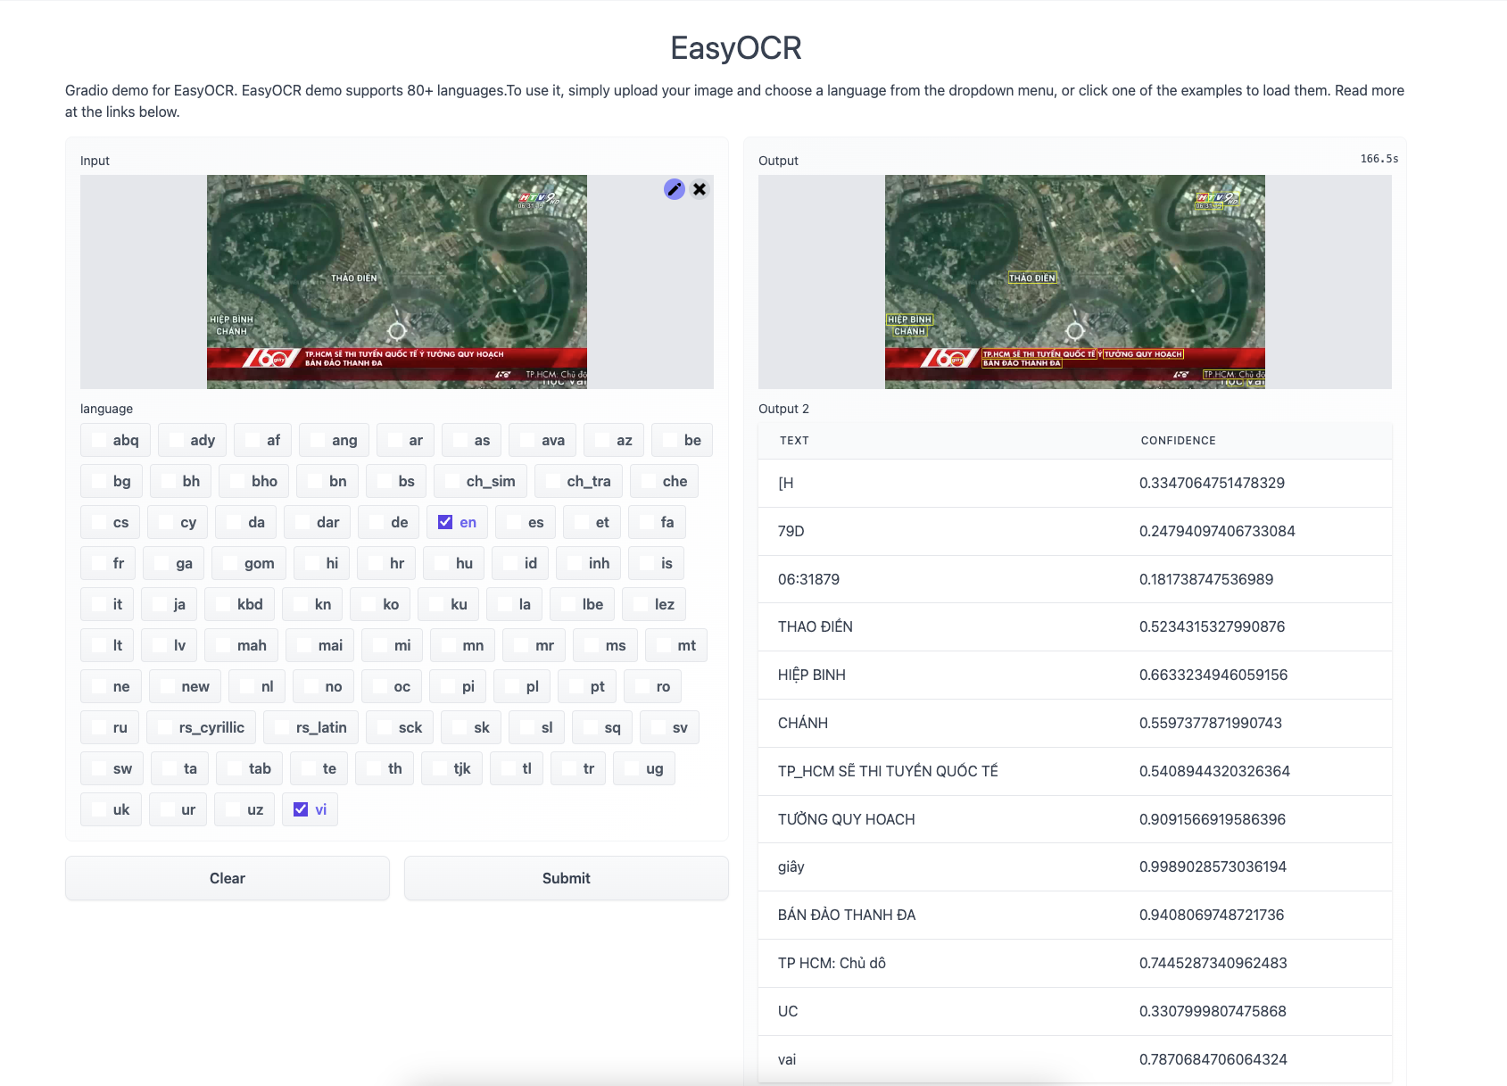
Introduction
AI VIETNAM
All-in-One Course
(TA Session)
OCR demo
Ref: https://huggingface.co/spaces/tomofi/EasyOCR
10

Slide 11
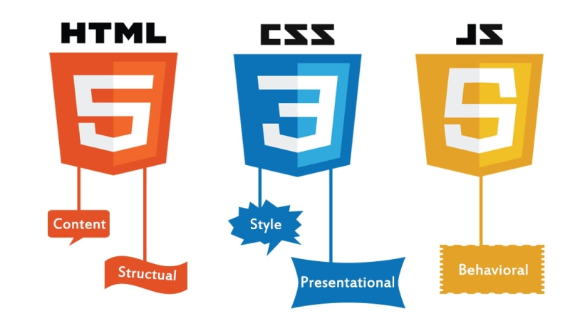
Introduction
AI VIETNAM
All-in-One Course
(TA Session)
Web application
11

Slide 12
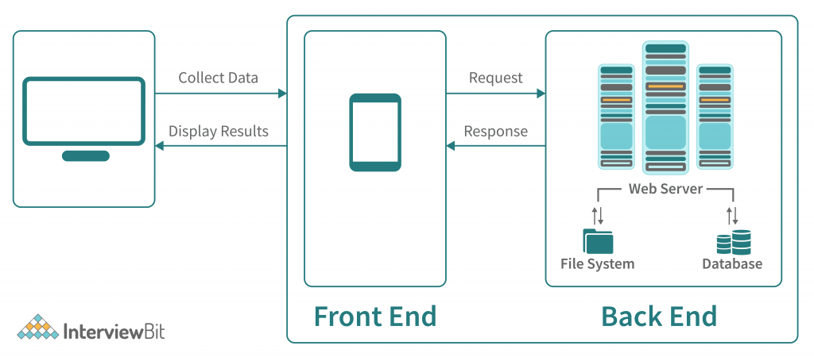
Introduction
AI VIETNAM
All-in-One Course
(TA Session)
Web Development
Ref: https://www.interviewbit.com/blog/web-application-architecture
12

Slide 13
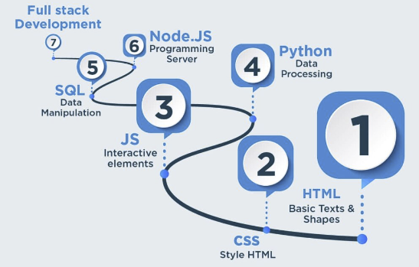
Introduction
AI VIETNAM
All-in-One Course
(TA Session)
Web Development
13

Slide 14




Introduction
AI VIETNAM
All-in-One Course
(TA Session)
No HTML - No CSS - No JavaScript
14

Slide 15
AI VIETNAM
All-in-One Course
(TA Session)
Streamlit

Slide 16

Streamlit
AI VIETNAM
All-in-One Course
(TA Session)
Getting Started
Streamlit’s open-source app framework is a breeze to get started with.
Ref: https://streamlit.io
16

Slide 17
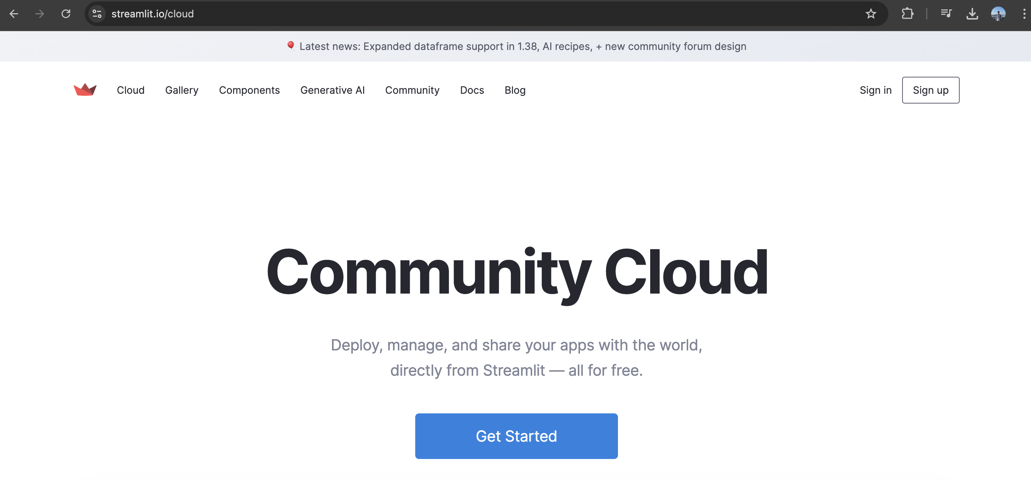
Streamlit
AI VIETNAM
All-in-One Course
(TA Session)
Getting Started
Streamlit also supports deploying applications built with Streamlit to the cloud easily and quickly.
Ref: https://streamlit.io
17

Slide 18
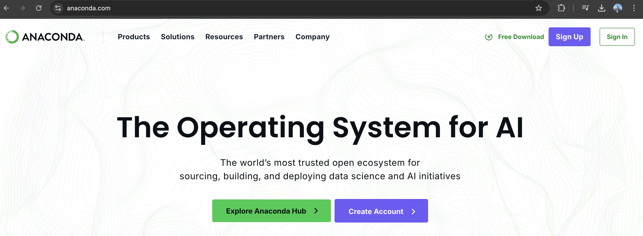
Streamlit
AI VIETNAM
All-in-One Course
(TA Session)
Installation
>> conda create –n streamlit_env python=3.11.9
>> conda activate streamlit_env
>> pip3 install streamlit==1.39.0
Ref: https://www.anaconda.com
18

Slide 19
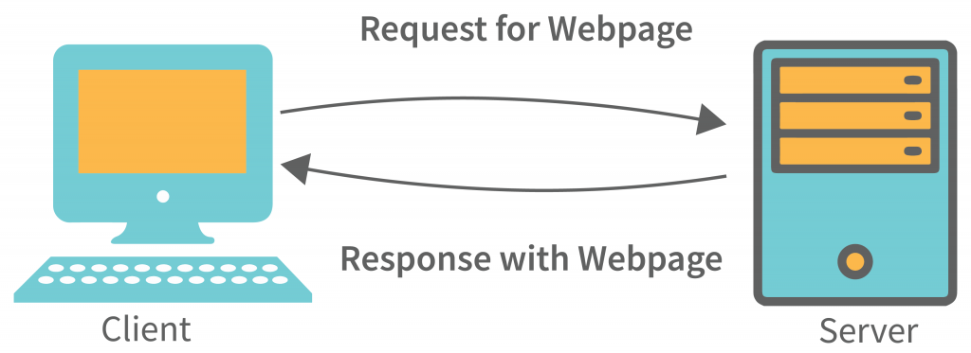
Streamlit
AI VIETNAM
All-in-One Course
(TA Session)
Architecture
>> streamlit run app.py
Frontend
(Browser)
Python Backend
19

Slide 20
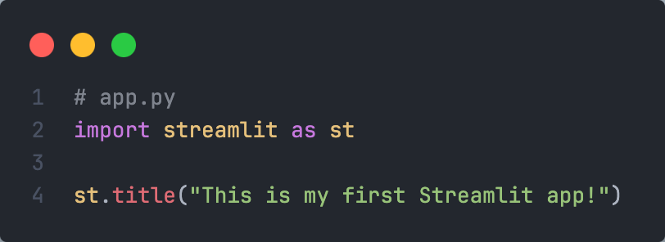
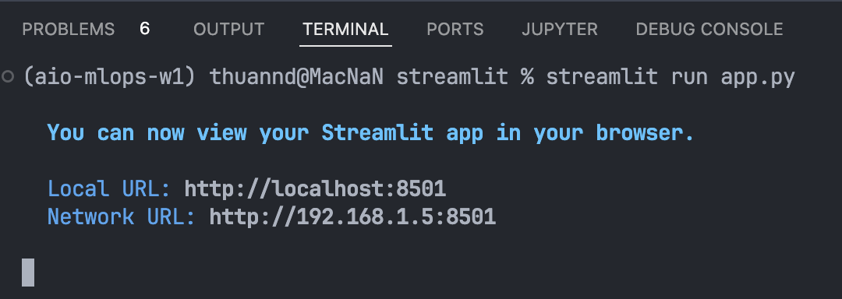
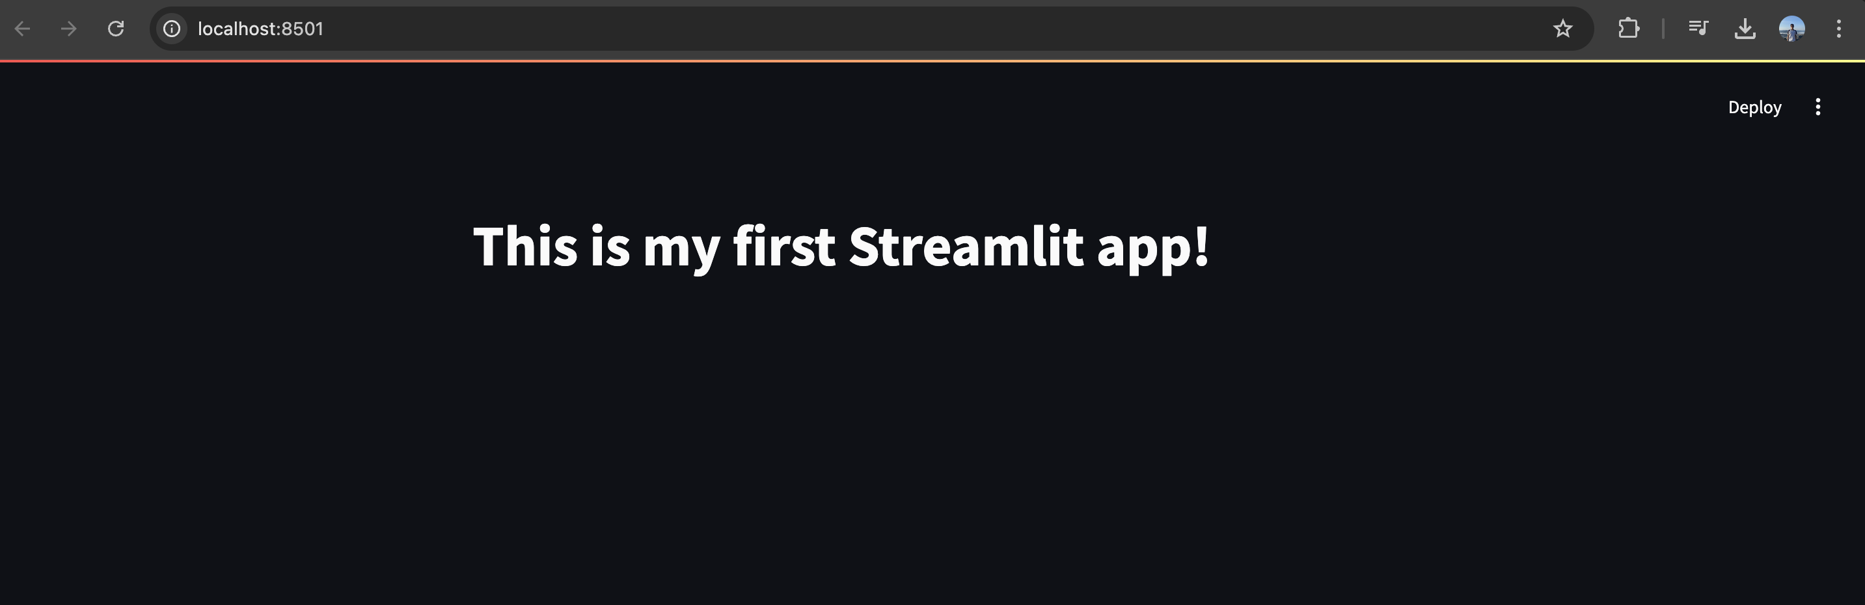
Streamlit
AI VIETNAM
All-in-One Course
(TA Session)
First app
20

Slide 21
AI VIETNAM
All-in-One Course
(TA Session)
Text element

Slide 22
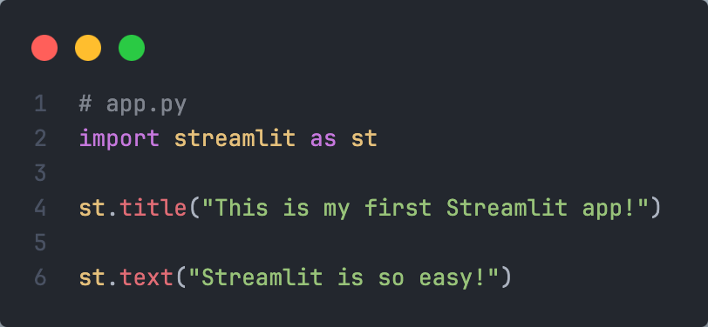
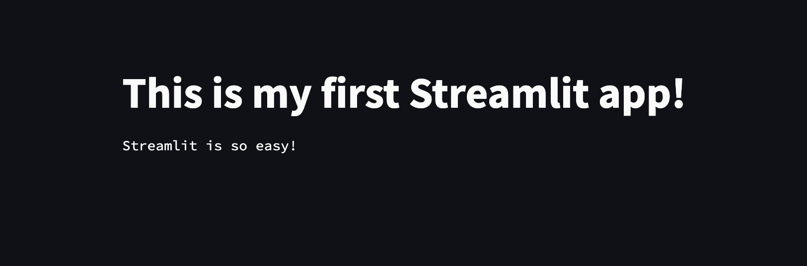
Text element
AI VIETNAM
All-in-One Course
(TA Session)
st.text
22

Slide 23
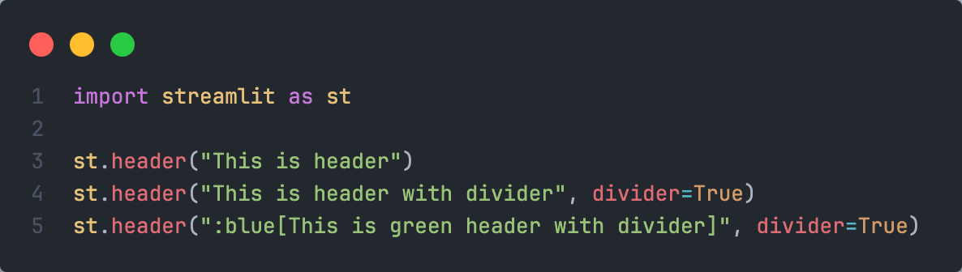
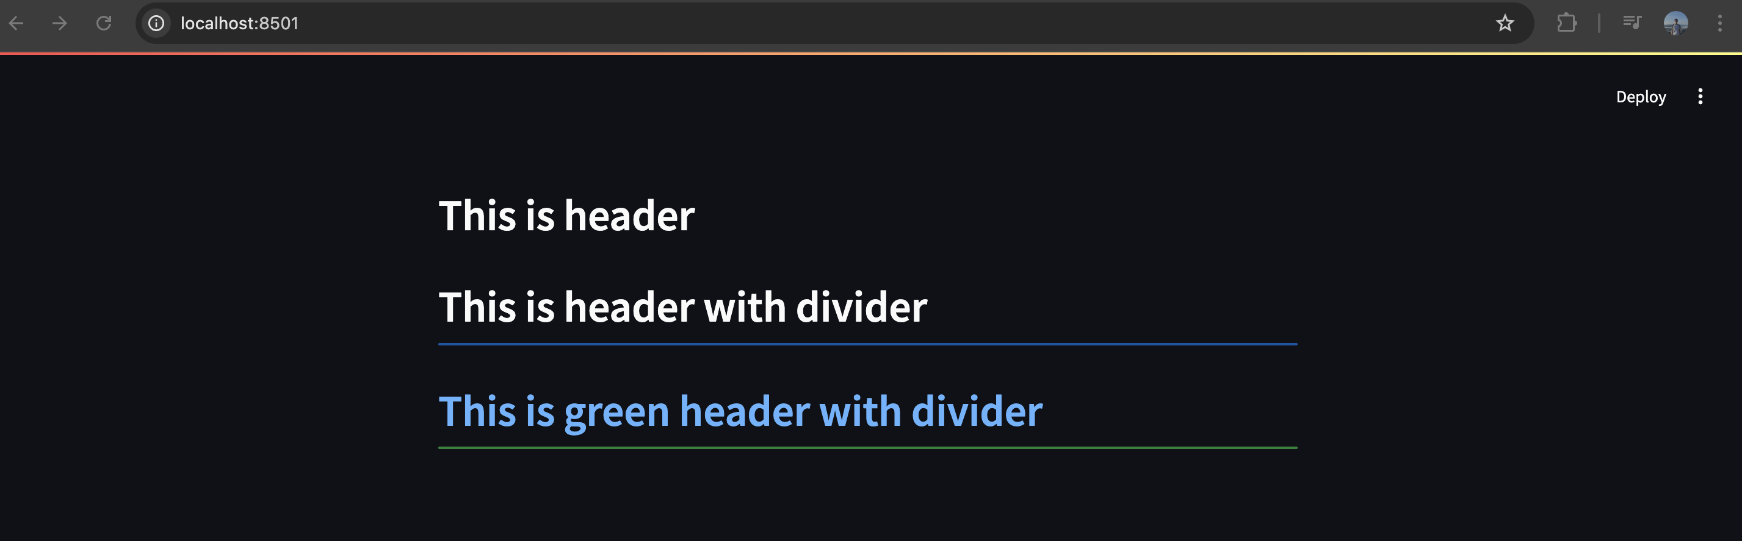
Text element
AI VIETNAM
All-in-One Course
(TA Session)
st.header
23

Slide 24
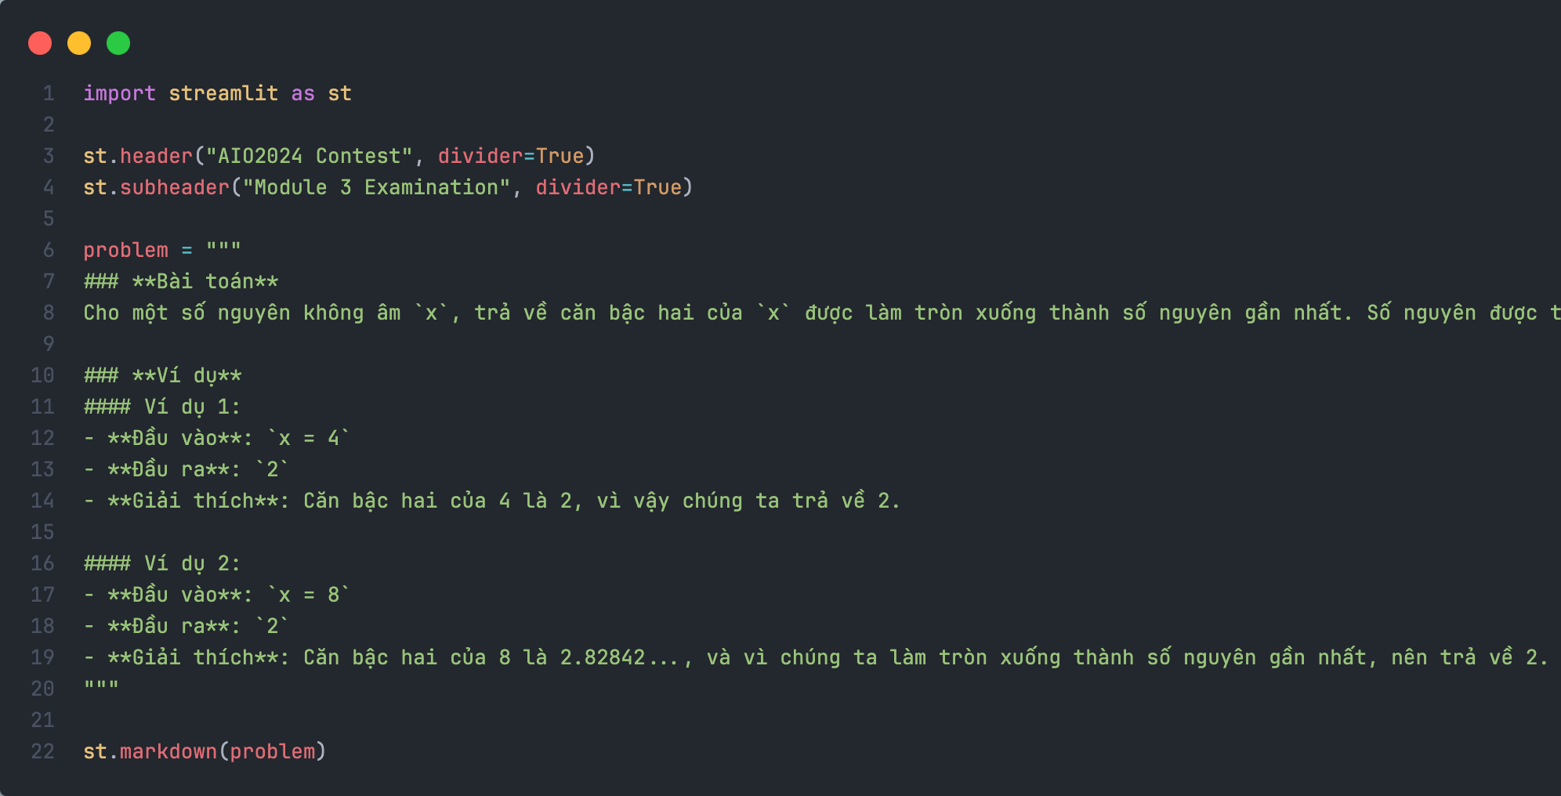
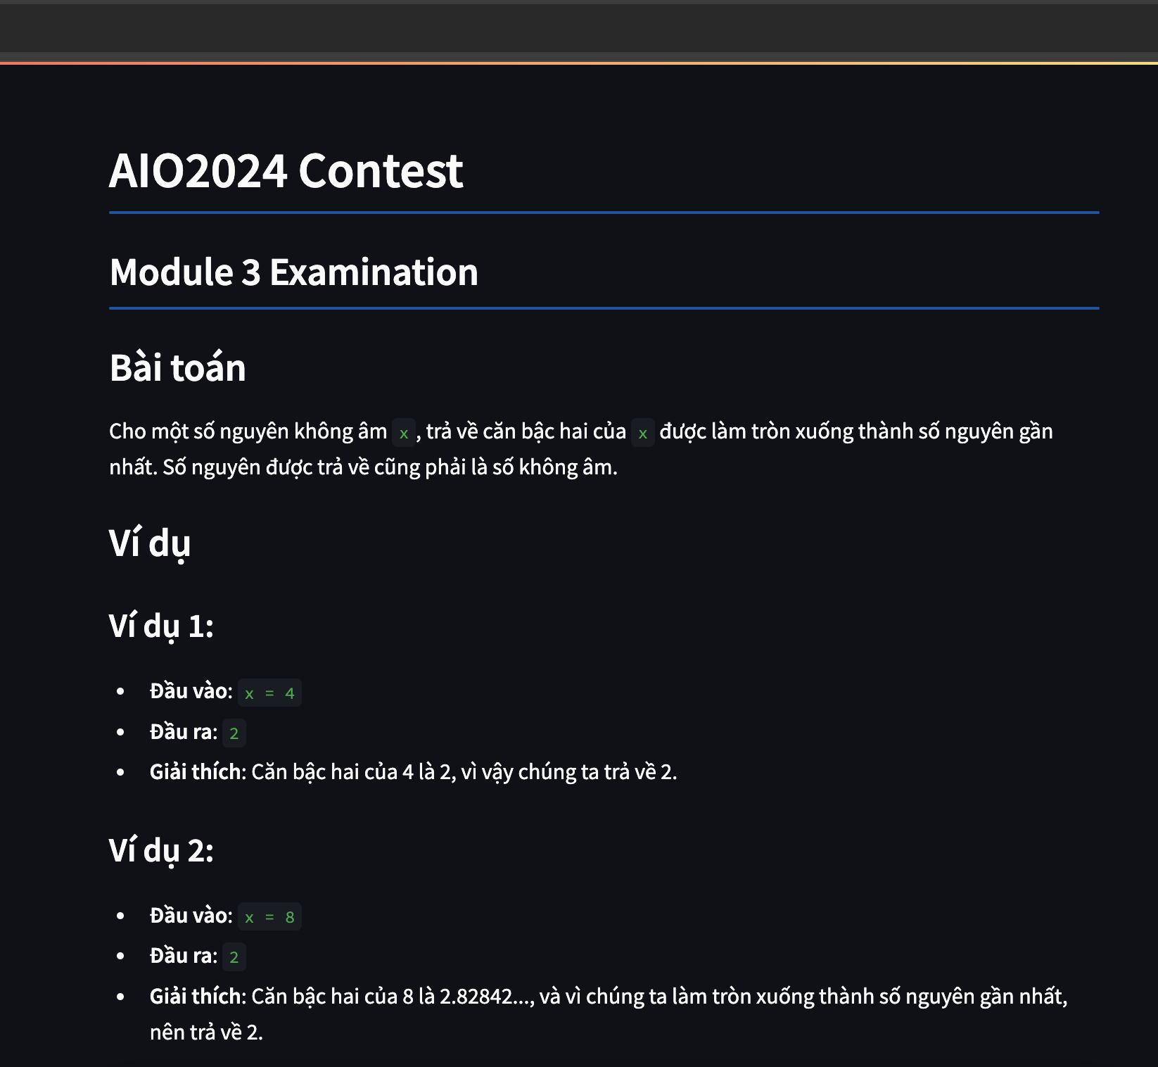
Text element
AI VIETNAM
All-in-One Course
(TA Session)
st.markdown
24

Slide 25
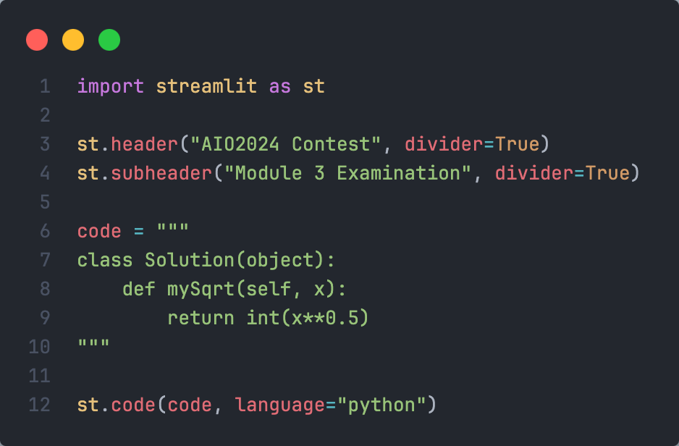
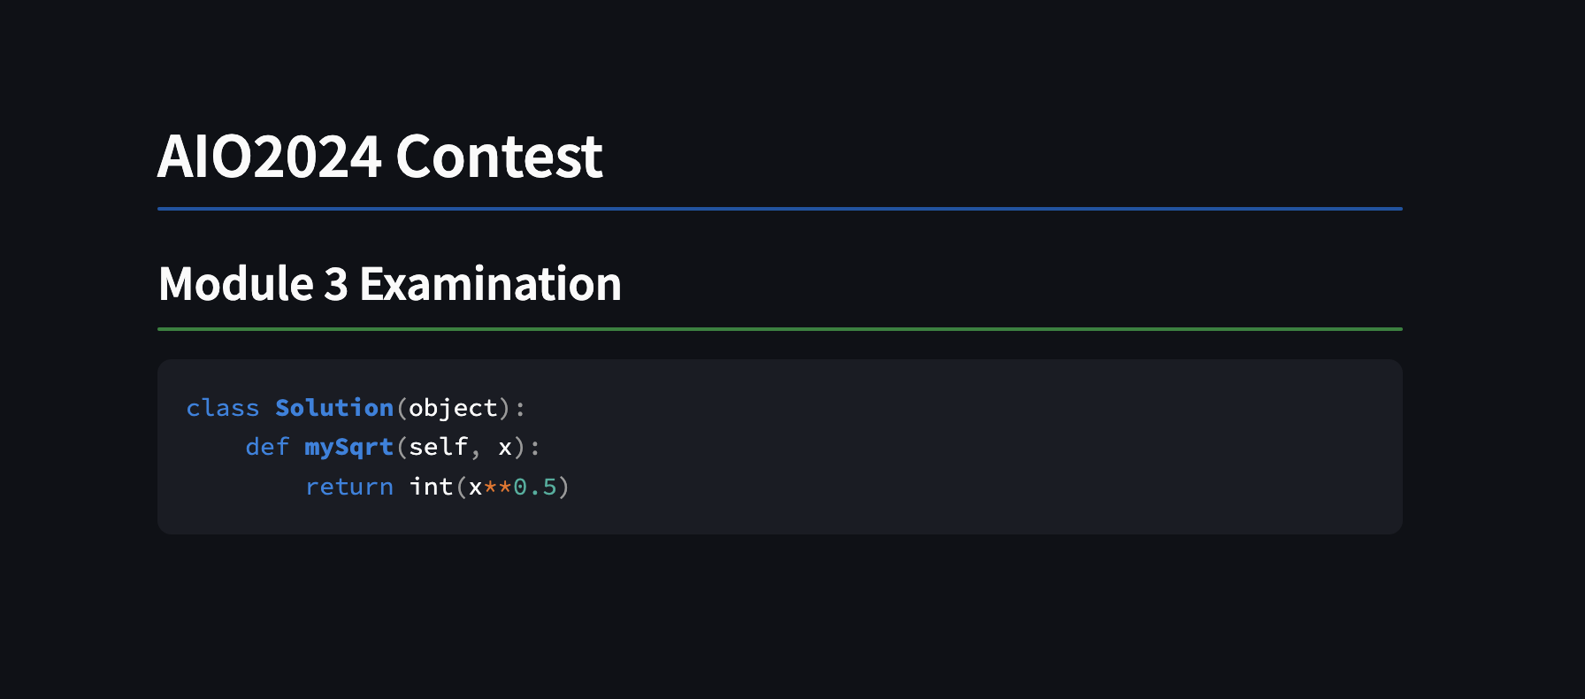
Text element
AI VIETNAM
All-in-One Course
(TA Session)
st.code
25

Slide 26
AI VIETNAM
All-in-One Course
(TA Session)
Input element

Slide 27
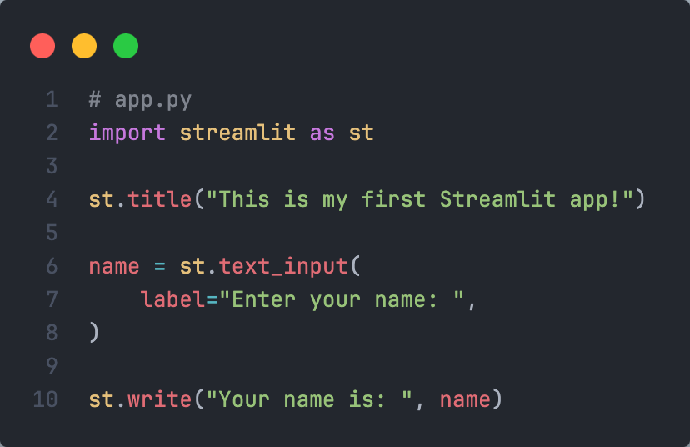
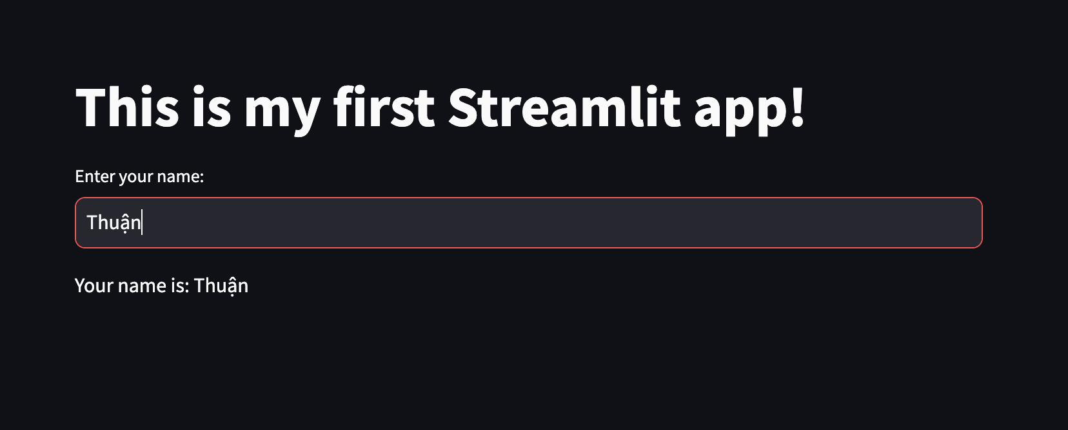
Input element
AI VIETNAM
All-in-One Course
(TA Session)
st.text_input
27

Slide 28
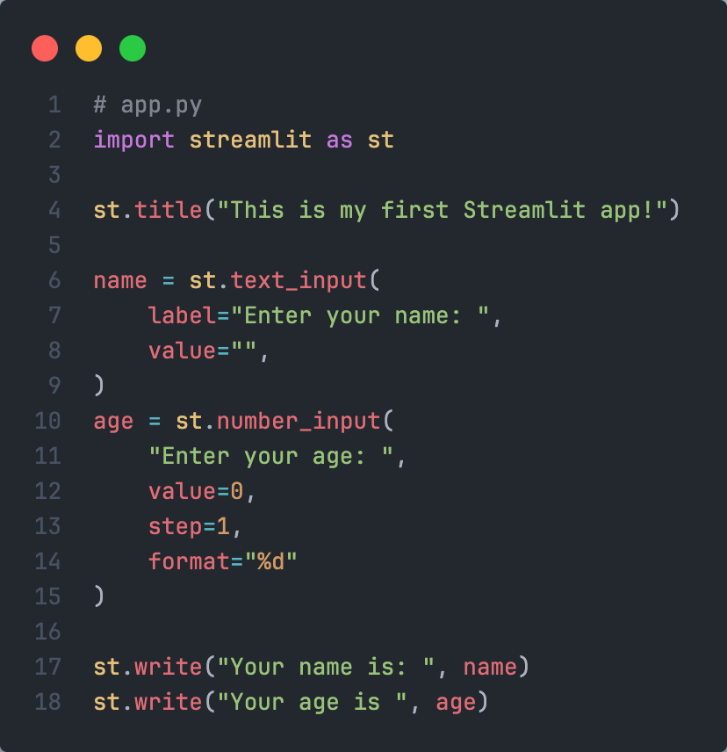
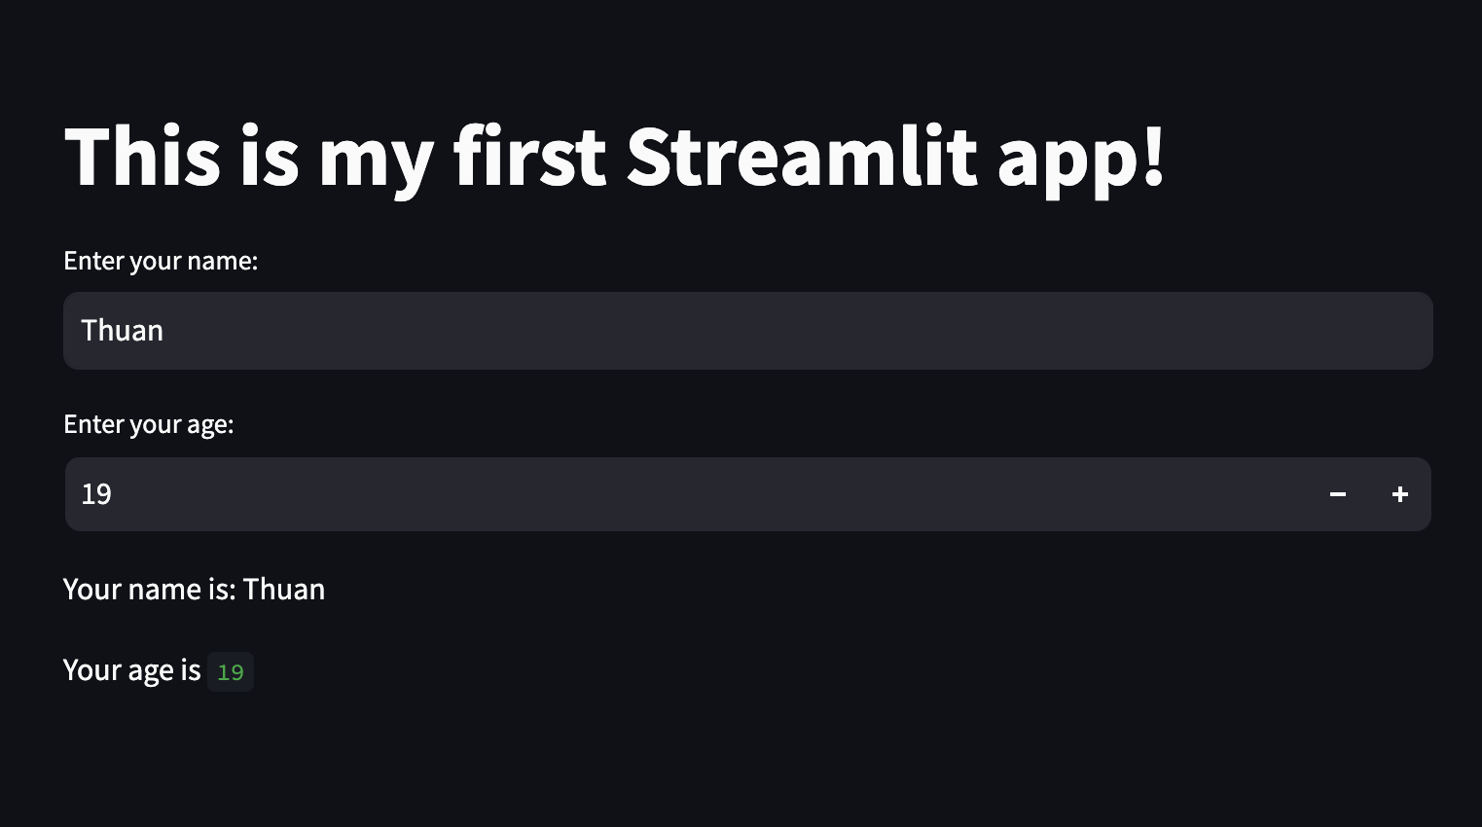
Input element
AI VIETNAM
All-in-One Course
(TA Session)
st.number_input
28

Slide 29
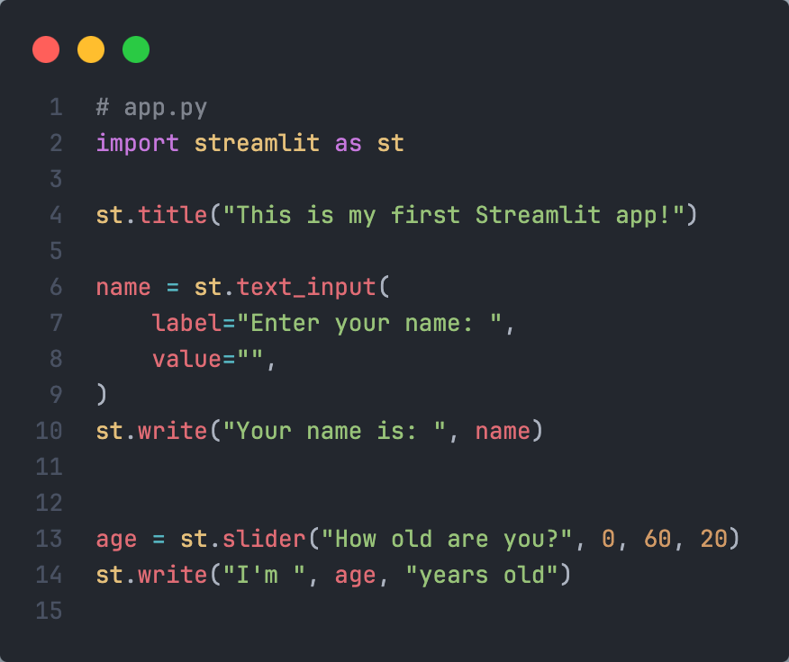
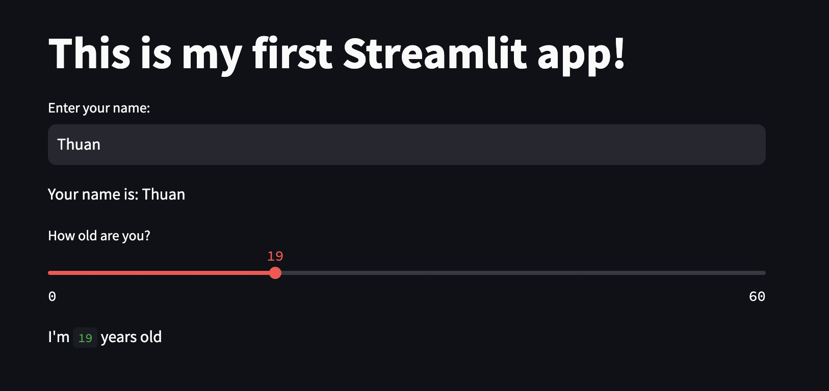
Input element
AI VIETNAM
All-in-One Course
(TA Session)
st.slider
29

Slide 30
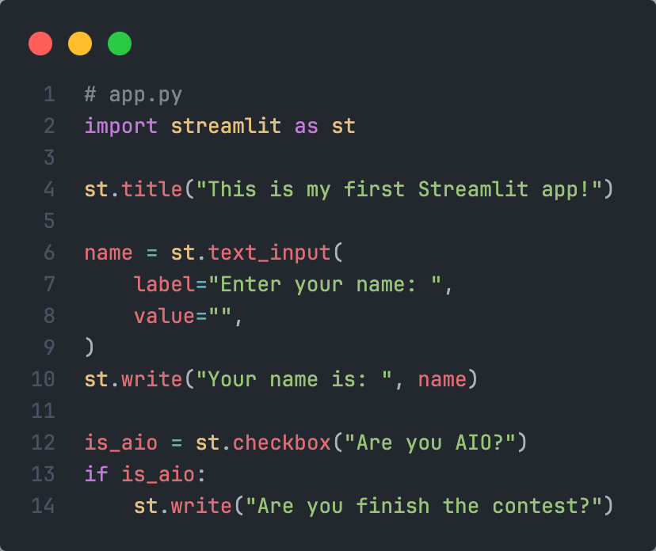
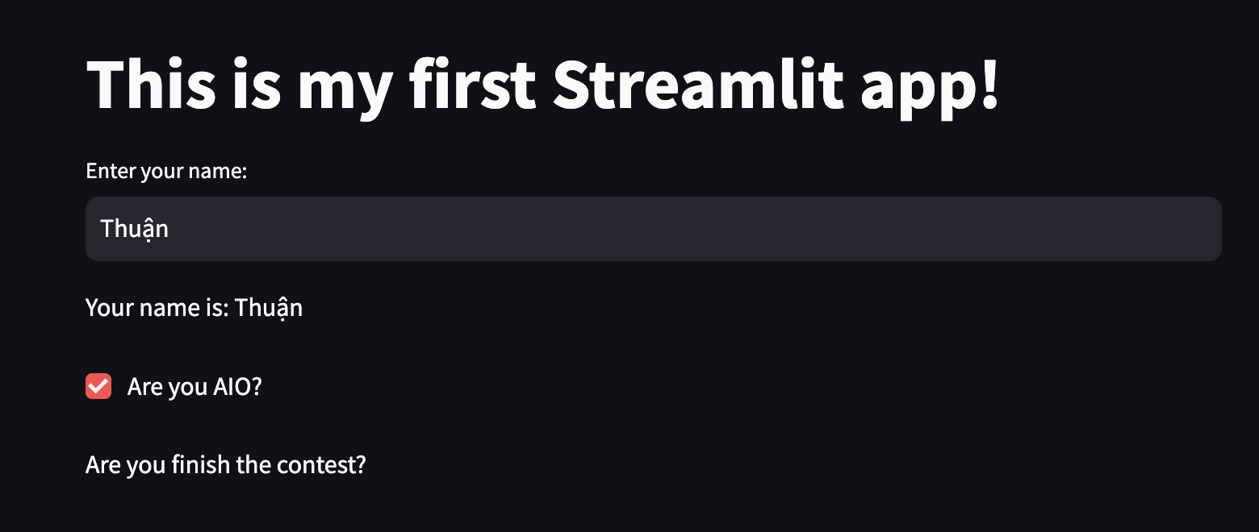
Input element
AI VIETNAM
All-in-One Course
(TA Session)
st.checkbox
30

Slide 31
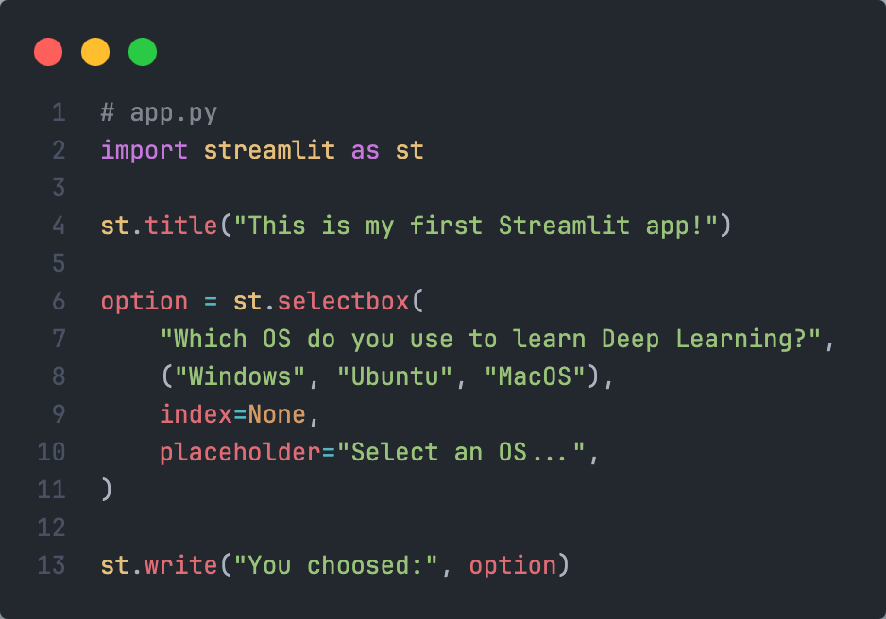
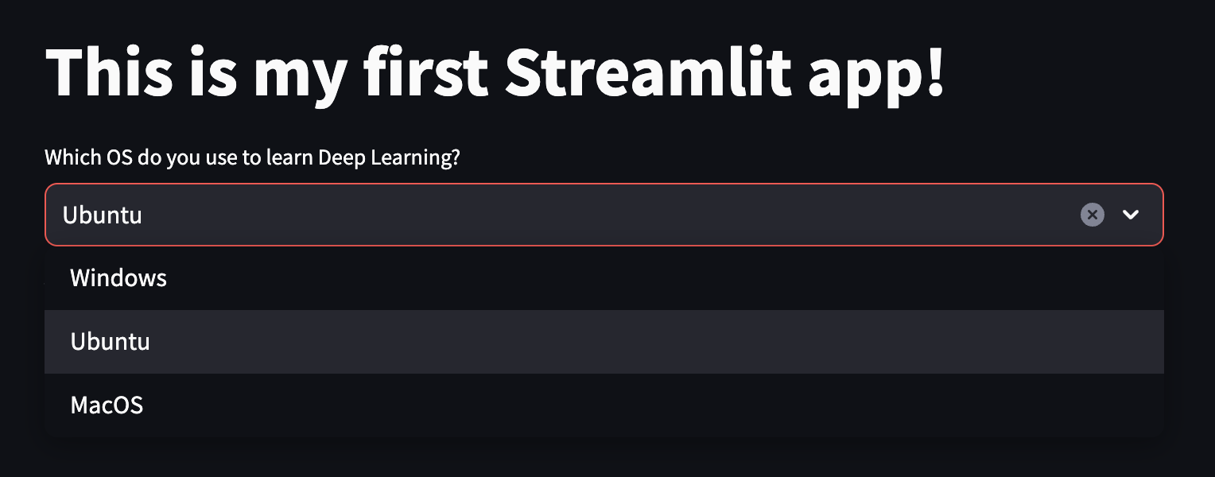
Input element
AI VIETNAM
All-in-One Course
(TA Session)
st.selectbox
31

Slide 32
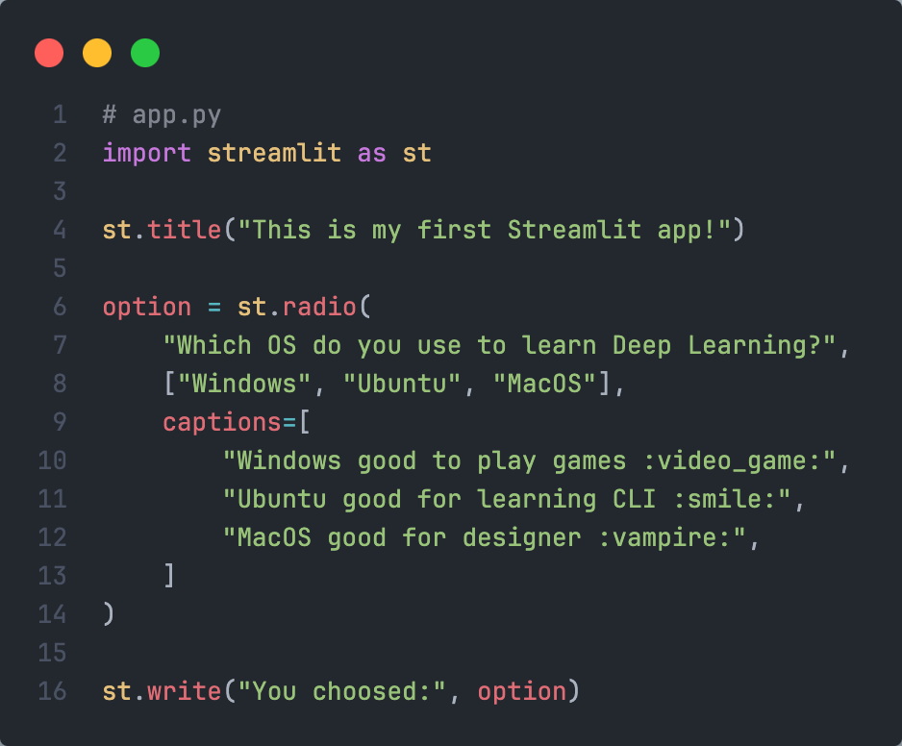

Input element
AI VIETNAM
All-in-One Course
(TA Session)
st.radio
32

Slide 33
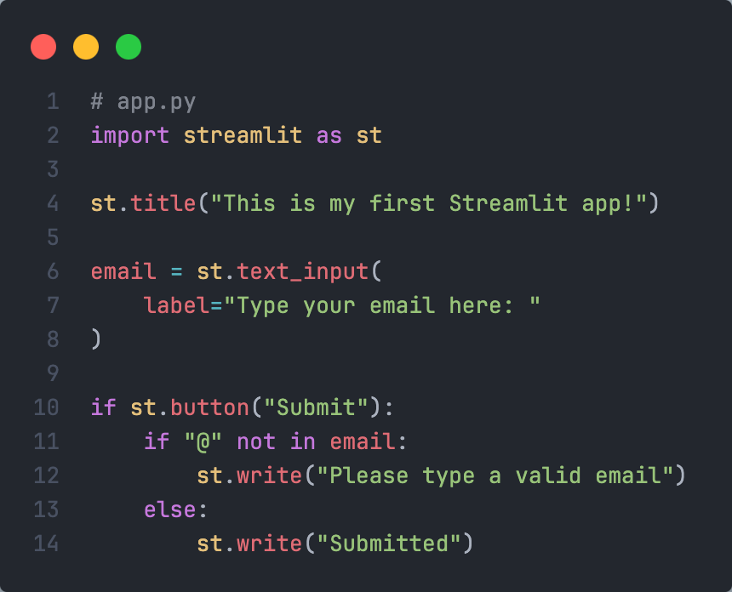
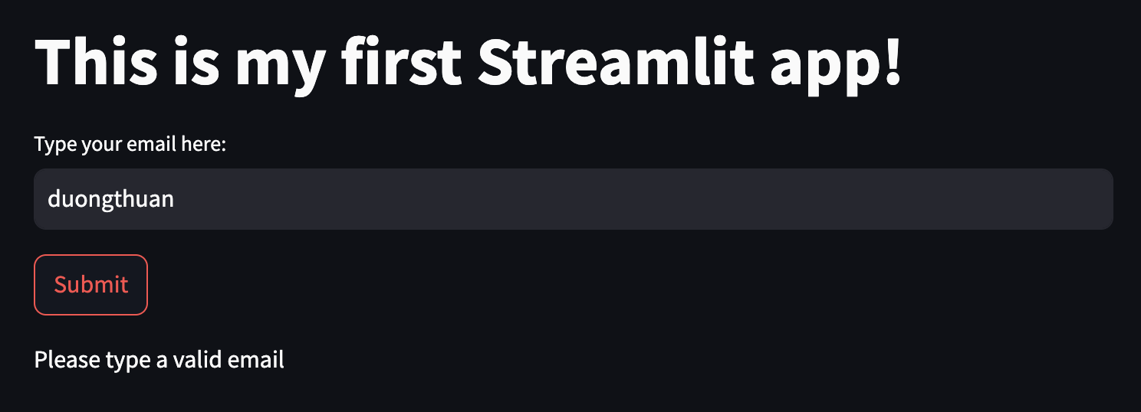
Input element
AI VIETNAM
All-in-One Course
(TA Session)
st.button
33

Slide 34
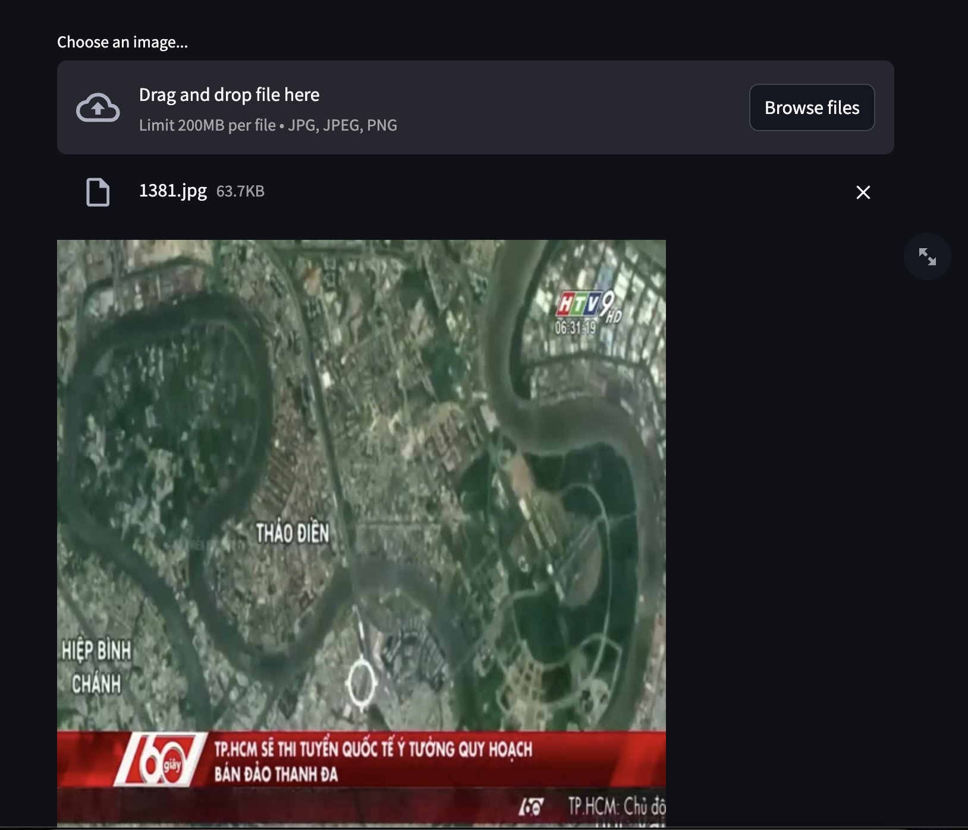
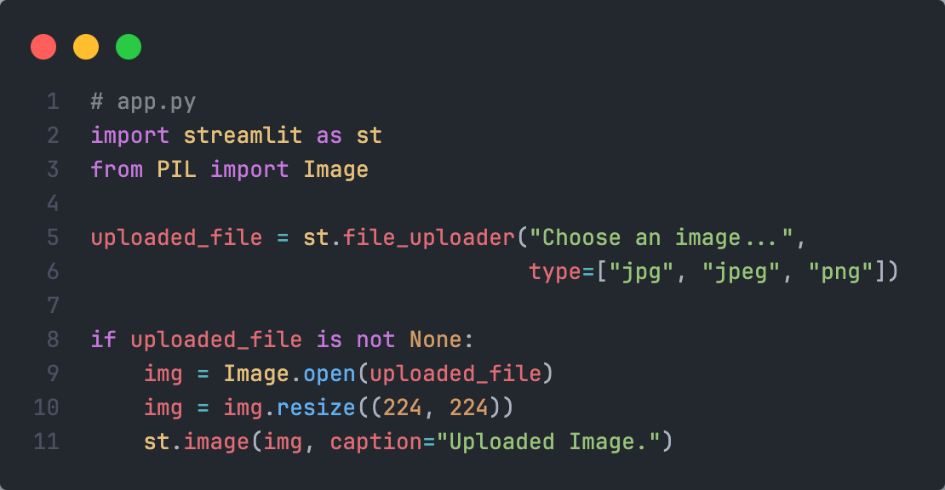
Input element
AI VIETNAM
All-in-One Course
(TA Session)
st.file_uploader
34

Slide 35
AI VIETNAM
All-in-One Course
(TA Session)
Media element

Slide 36
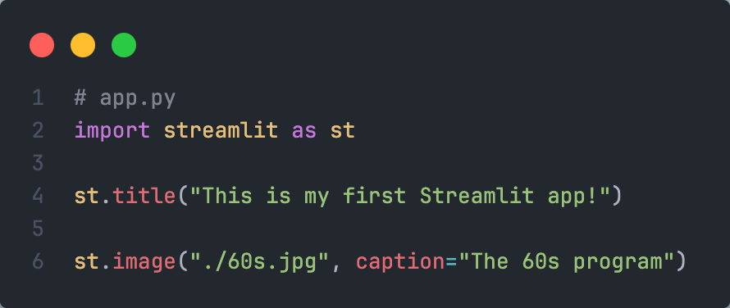
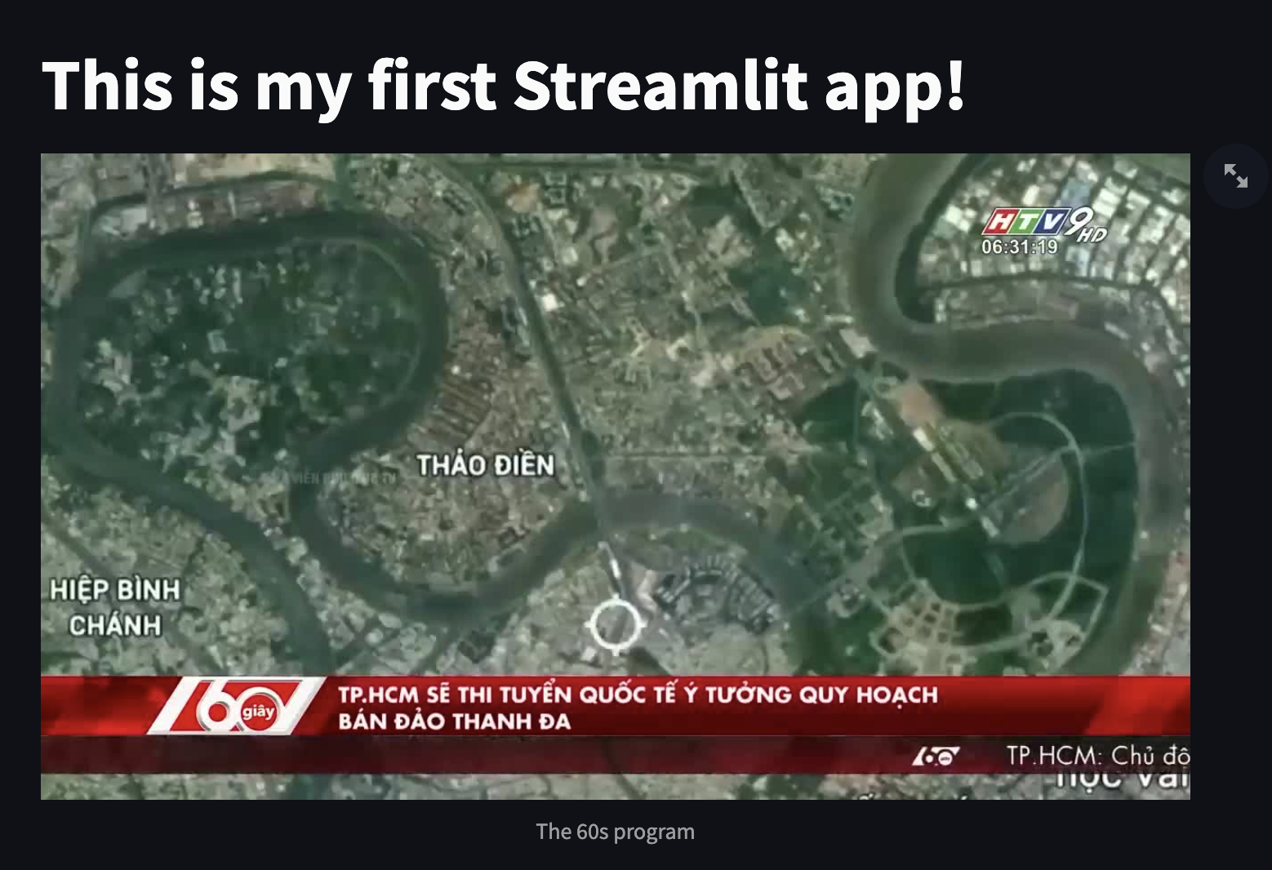
Media element
AI VIETNAM
All-in-One Course
(TA Session)
st.image
36

Slide 37
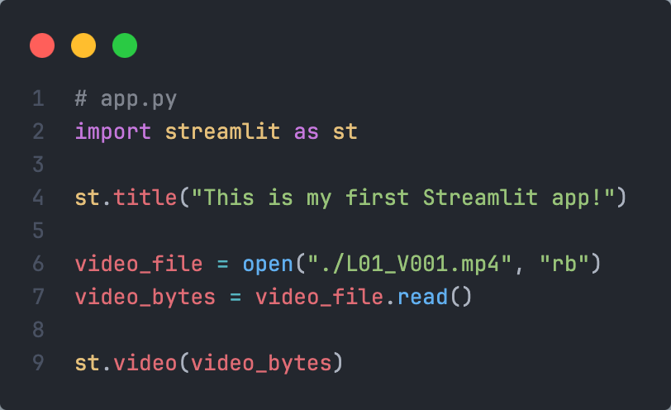
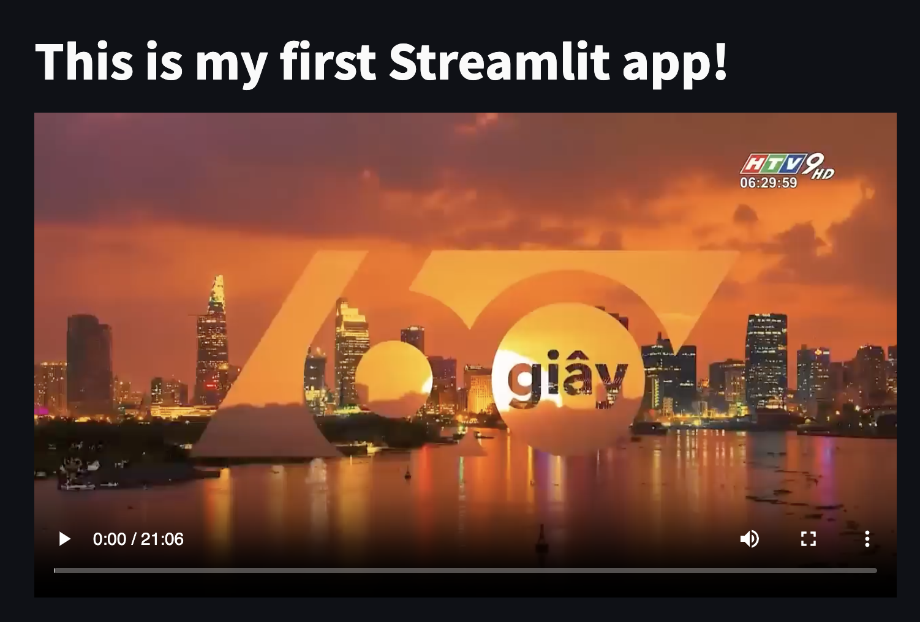
Media element
AI VIETNAM
All-in-One Course
(TA Session)
st.video
37

Slide 38
AI VIETNAM
All-in-One Course
(TA Session)
Layout element

Slide 39
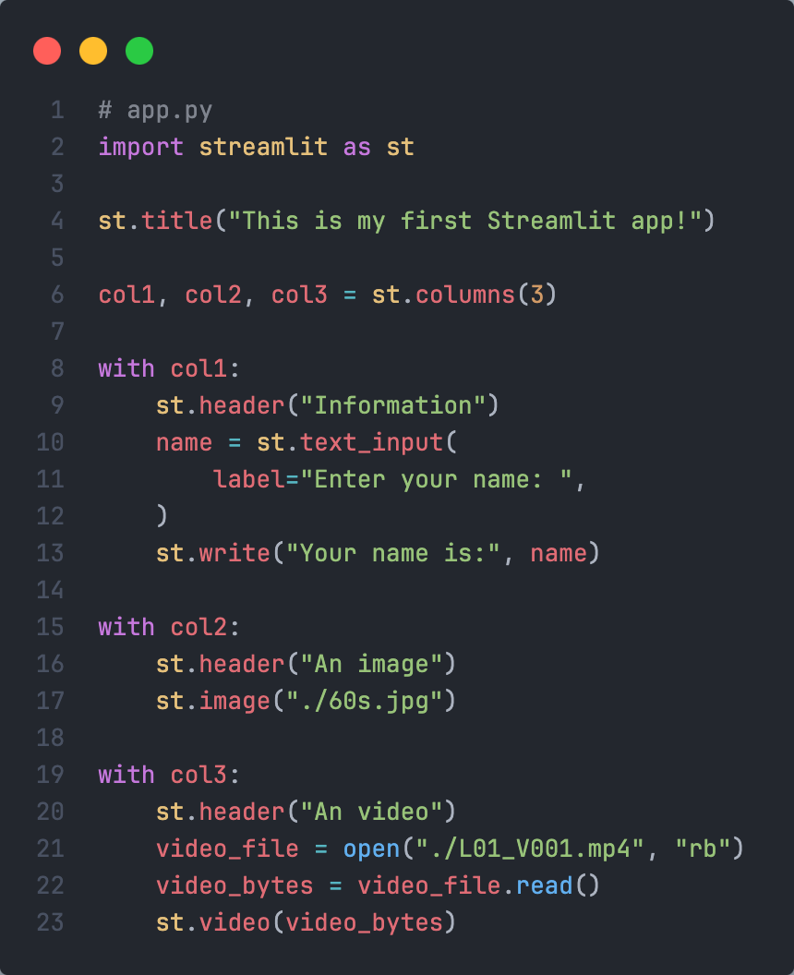
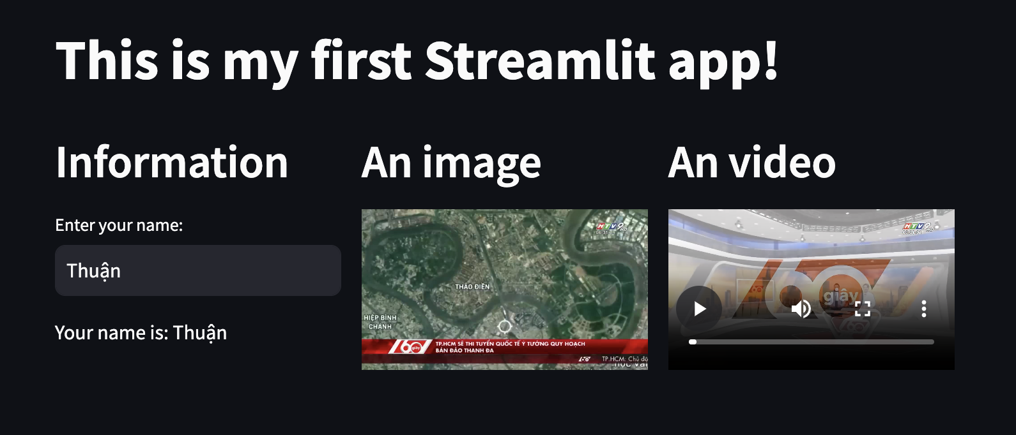
Layout element
AI VIETNAM
All-in-One Course
(TA Session)
st.columns
39

Slide 40
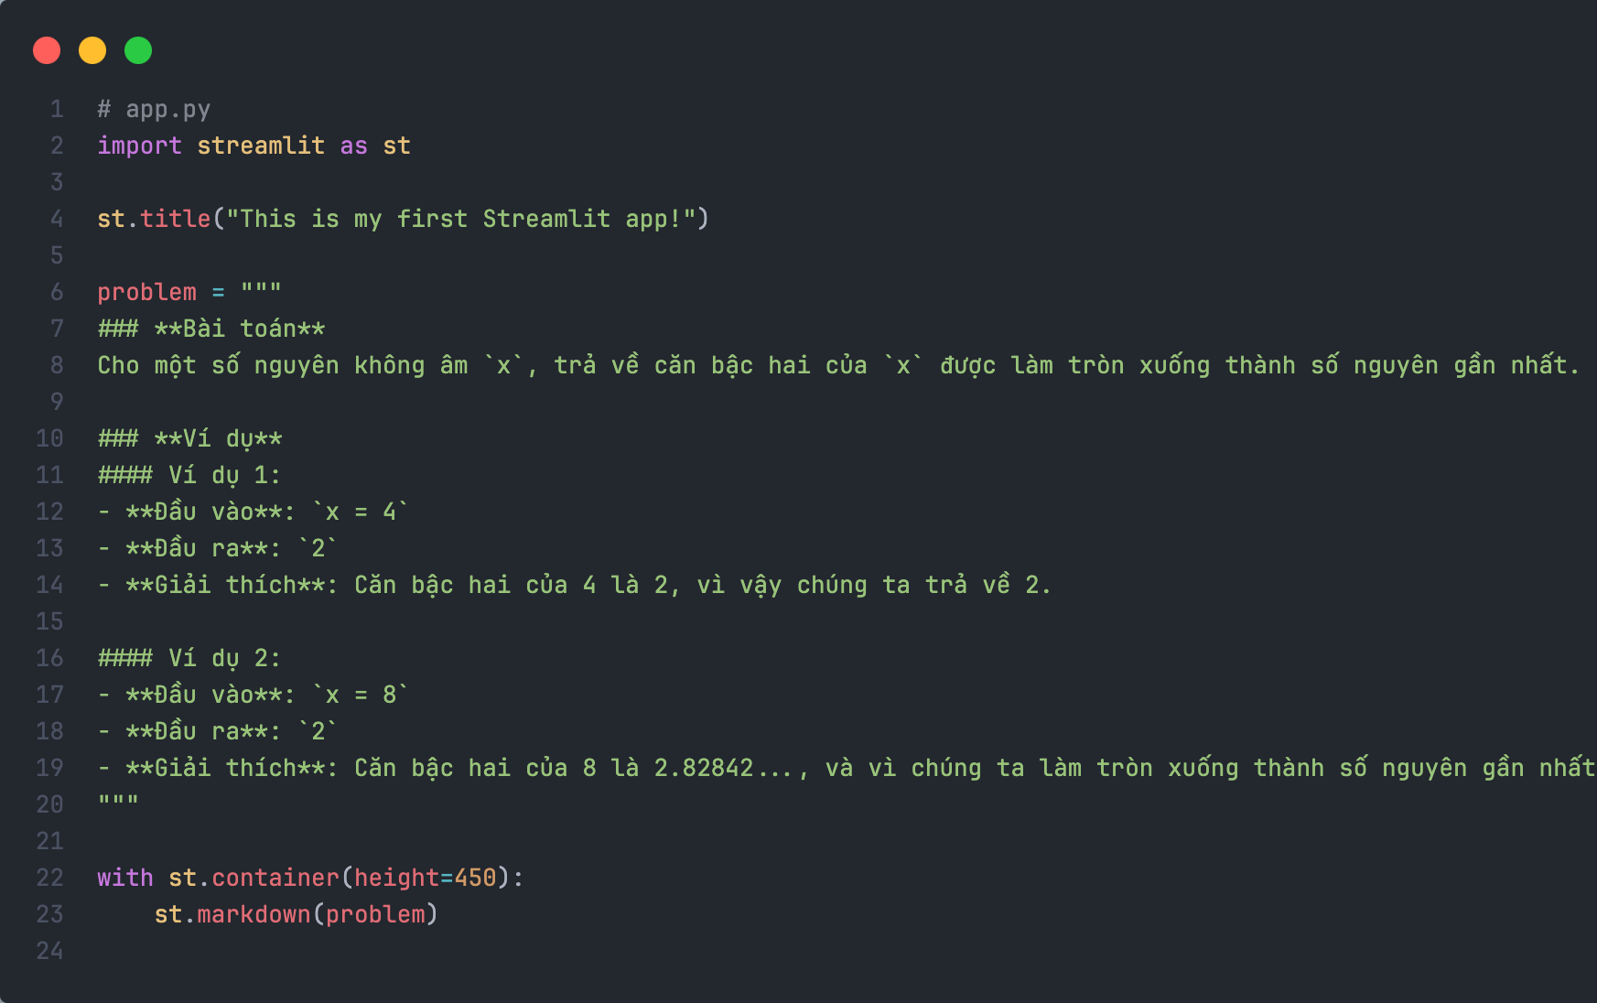
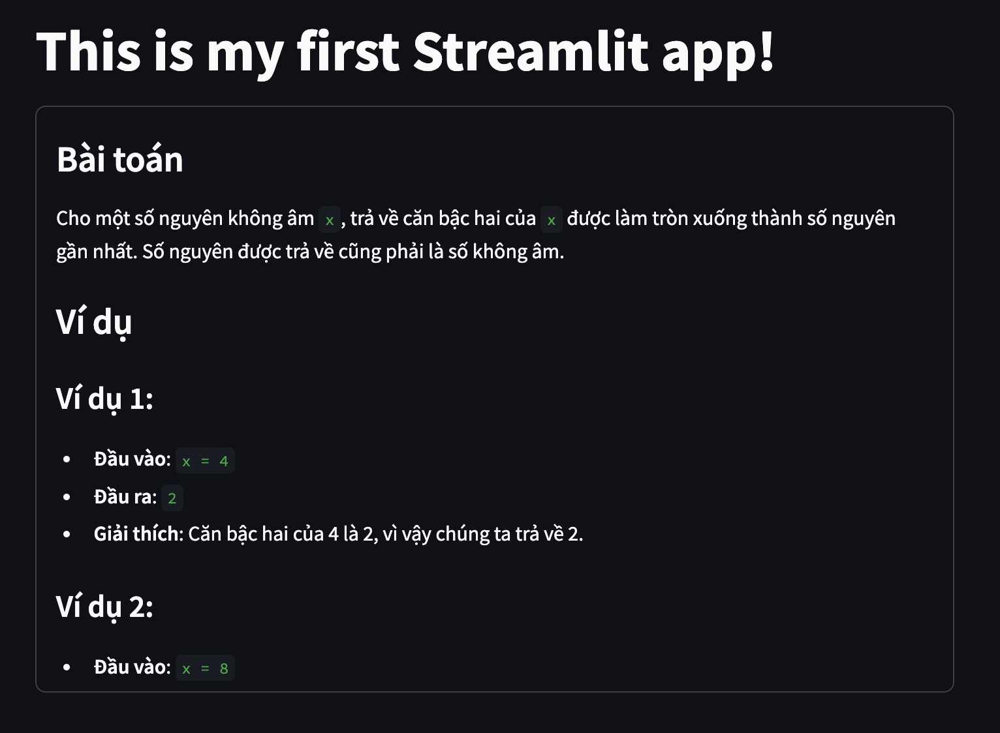
Layout element
AI VIETNAM
All-in-One Course
(TA Session)
st.container
40

Slide 41
AI VIETNAM
All-in-One Course
(TA Session)
Status element

Slide 42
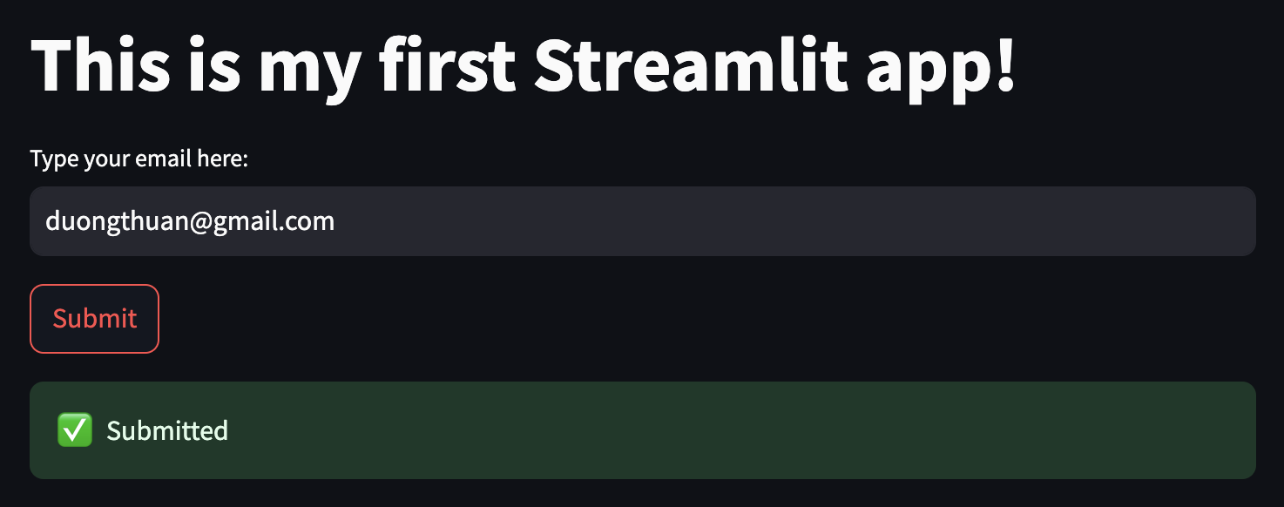
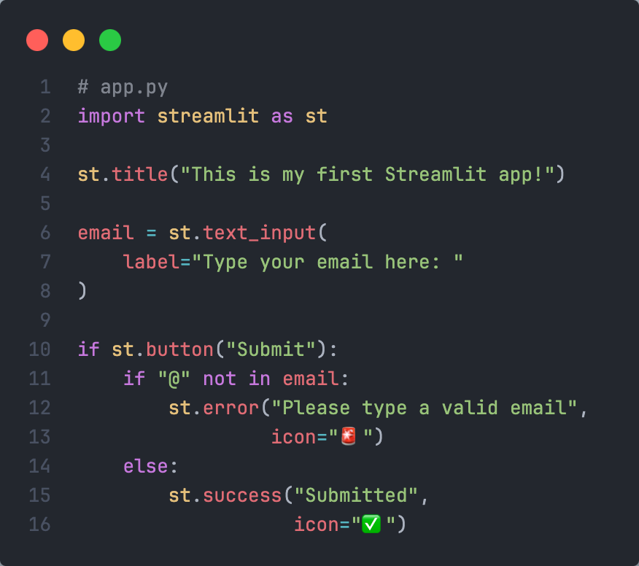
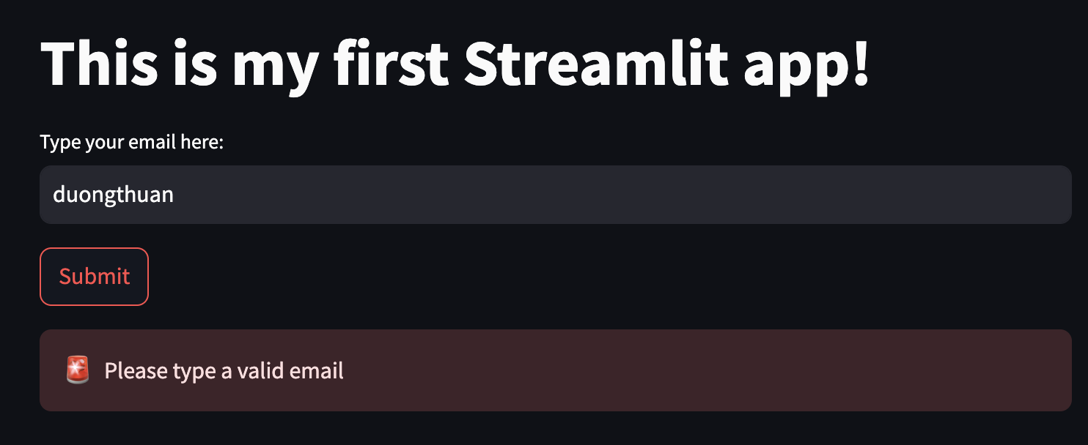
Status element
AI VIETNAM
All-in-One Course
(TA Session)
st.error / st.success
42

Slide 43
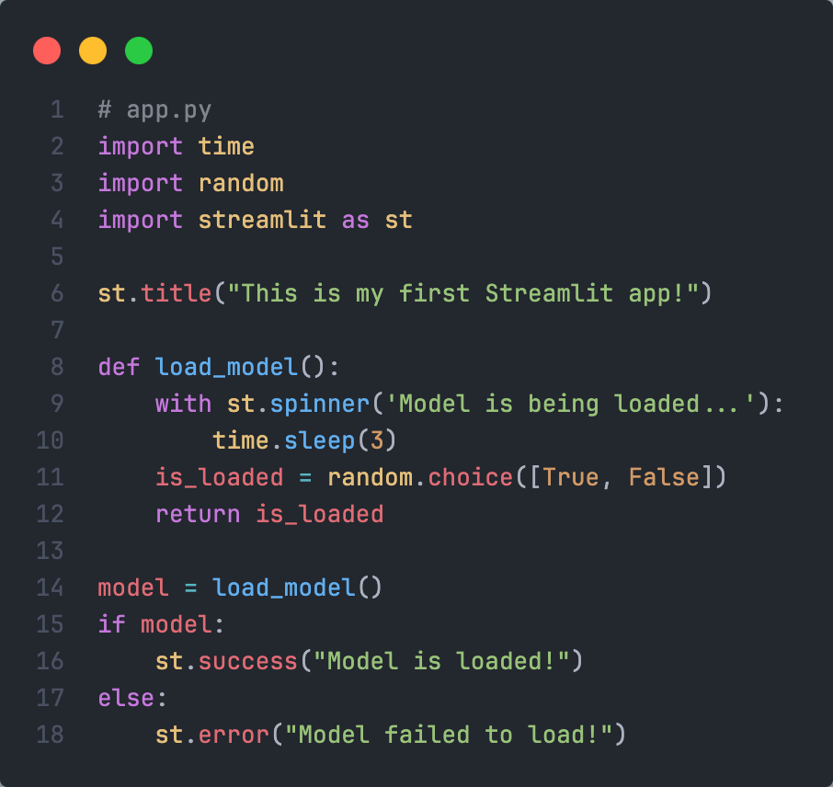
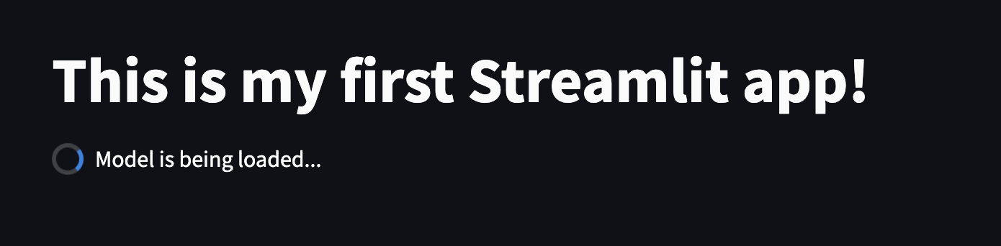
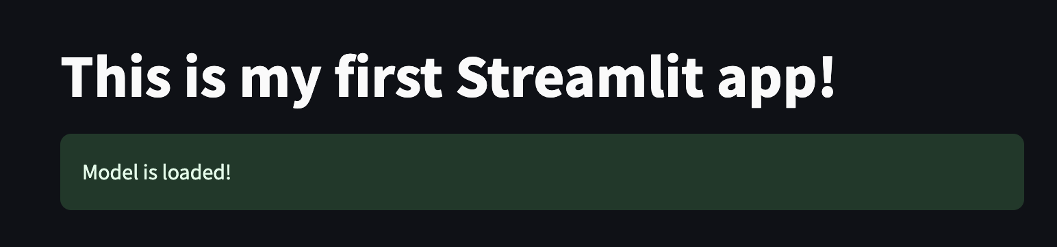

Status element
AI VIETNAM
All-in-One Course
(TA Session)
st.spinner
43

Slide 44
AI VIETNAM
All-in-One Course
(TA Session)
Gradio

Slide 45

Gradio
AI VIETNAM
All-in-One Course
(TA Session)
Getting Started
Ref: https://www.gradio.app
45

Slide 46
Gradio
AI VIETNAM
All-in-One Course
(TA Session)
Installation
>> conda create –n gradio_env python=3.11.9
>> conda activate gradio _env
>> pip3 install streamlit==4.44.1
46

Slide 47
Gradio
AI VIETNAM
All-in-One Course
(TA Session)
Architecture
>> python app.py
>> gradio app.py
Frontend
(Browser)
Python Backend
47

Slide 48



Gradio
AI VIETNAM
All-in-One Course
(TA Session)
First app
48

Slide 49
AI VIETNAM
All-in-One Course
(TA Session)
Gradio with Interface

Slide 50


Interface
AI VIETNAM
All-in-One Course
(TA Session)
Input element
50

Slide 51


Interface
AI VIETNAM
All-in-One Course
(TA Session)
Input element
51

Slide 52


Interface
AI VIETNAM
All-in-One Course
(TA Session)
Input element
52

Slide 53


Interface
AI VIETNAM
All-in-One Course
(TA Session)
Input element
53

Slide 54


Interface
AI VIETNAM
All-in-One Course
(TA Session)
Input element
54

Slide 55


Interface
AI VIETNAM
All-in-One Course
(TA Session)
Input element
55

Slide 56
AI VIETNAM
All-in-One Course
(TA Session)
Gradio with Block

Slide 57


Block
AI VIETNAM
All-in-One Course
(TA Session)
Click event
57

Slide 58


Block
AI VIETNAM
All-in-One Course
(TA Session)
Change event
58

Slide 59


Block
AI VIETNAM
All-in-One Course
(TA Session)
Layout
59

Slide 60


Block
AI VIETNAM
All-in-One Course
(TA Session)
Layout
60

Slide 61
AI VIETNAM
All-in-One Course
(TA Session)
Hands-on

Slide 62

Hands-on
AI VIETNAM
All-in-One Course
(TA Session)
Housing Price
62

Slide 63

Hands-on
AI VIETNAM
All-in-One Course
(TA Session)
OCR
63

Slide 64
AI VIETNAM
All-in-One Course
(TA Session)
Conclusion

Slide 65
Conclusion
AI VIETNAM
All-in-One Course
(TA Session)
Machine Learning Model
Application 1
Deep Learning Model
Application 2
Functions
Application …
65

Slide 66
Question
AI VIETNAM
All-in-One Course
(TA Session)
?

Slide 67


